Slide 1

UNIVERSITY INSTITUTE ENGINEERING
DEPARTMENT ACADEMIC UNIT-1
Bachelor of Engineering (Computer Science Engineering)
SUBJECT NAME: INTRODUCTION TO ELECTRICAL & ELECTRONICS ENGINEERING
SUBJECT CODE : 23ECH-101
By
Dr. Shikha
Unit-3, Chapter-1
Lecture No. 3.1.7
INTRODUCTION TO INDUCTION MOTOR
DISCOVER . LEARN . EMPOWER

Slide 2
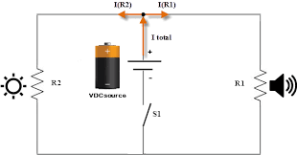
LECTURE OBJECTIVES
S. No. | Objectives
1 | To make student aware about the basic concept of single phase induction motor
2 | To aware about construction and working principle of single phase induction motor
3 | To provide knowledge about squirrel cage and phase wound rotor with their difference
4 | To make familiar with introduction to three phase induction motor with construction and working operation
5 | To give brief knowledge about applications of induction motor
https://library.automationdirect.com/basic-electrical-theory/

Slide 3
Course Objectives
S. No. | Objectives
1 | Understand Electrical & Electronics Engineering Fundamentals
2 | To prepare students to perform the analysis and design of various Electrical & digital electronic circuits.
https://library.automationdirect.com/basic-electrical-theory/

Slide 4
Course Outcomes
CO Number | Title | Level
CO1 | To identify the different types of electrical elements and the basic op-amp circuit elements and to illustrate the various types of motors, transducers. | Remember
CO2 | To understand basic principles of transformers, transducers, op-amps, DC and AC motors and to compare the different methods for analysing electrical and magnetic circuits. | Understand
CO3 | To derive the relationships between parameters in electric and magnetic circuits and motors and to determine specifications of op-amps. | Analyze
CO4 | To solve the basic problems related to electric circuits, magnetic circuits and motors and to assess the characteristics of different configurations of op-amps. | Evaluate
CO5 | To design the different applications of transducers, motors as well as the op-amps like adders, subtractor and comparators. | Create
https://library.automationdirect.com/basic-electrical-theory/

Slide 5

IMPORTANCE OF COURSE[BEEE]
Use in communication and satellite navigation system.
Handles in electronics equipment and computers.
Deals with the problem of power transmission and motor control.
Handles with robotics applications.
https://images.app.goo.gl/JY2jmAuASfpDUENZ8

Slide 6
CONTENTS
Introduction to single phase induction motor
Basic construction of single phase induction motor
Advantages and disadvantages of squirrel cage and slip ring rotor
Working principle of single phase induction motor
Applications of single phase induction motor
Introduction to three phase induction motor with construction and working principle
Advantages and disadvantages of three phase induction motor
Applications of three phase induction motor

Slide 7
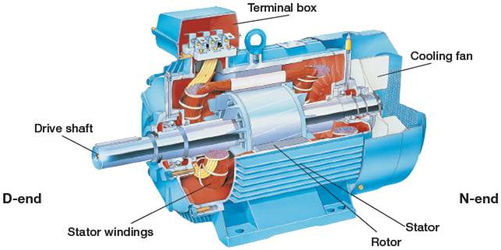
SINGLE PHASE INDUCTION MOTOR
TOPIC NAME: INTRODUCTION TO SINGLE PHASE INDUCTION MOTOR
Fig.1
https://university.listenlights.com/2017/08/03/induction-motors/

Slide 8
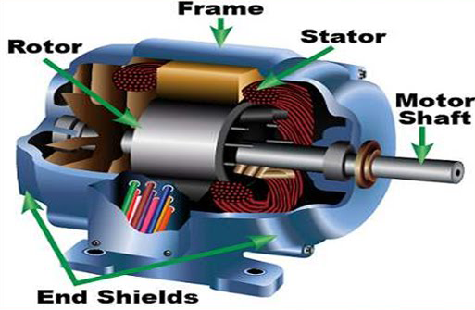
SINGLE PHASE INDUCTION MOTOR
Single-phase a.c supply is commonly used for lighting purpose in shops, offices, houses, schools etc.
Hence instead of d.c motors, the motors which work on single-phase a.c. supply are popularly used. These a.c motors are called single-phase induction motors.
Used in applications like small toys, small fans, hairdryers etc.
Fig.2
https://www.polytechnichub.com/construction-3-phase-induction-motor/

Slide 9
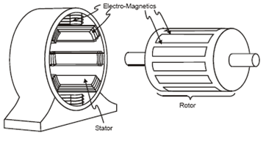
CONSTRUCTION OF SINGLE PHASE INDUCTION MOTOR
Single-phase induction motor also has two main parts, one rotating and other stationary.
The stationary part in single-phase induction motors is Stator and the rotating part is Rotor. The stator has laminated construction, made up of stampings.
The number of poles for which stator winding is wound decides the synchronous speed of the motor.
Fig.3
https://www.polytechnichub.com/construction-3-phase-induction-motor/

Slide 10
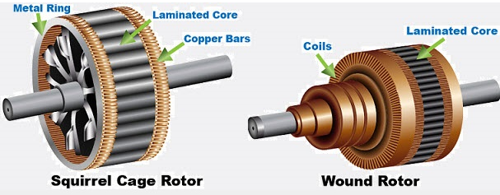
TYPES OF ROTOR
There are two types of rotor such as:
Squirrel cage rotor
Slip ring rotor
Fig.5
https://www.electricaledition.com/2017/06/squirrel-cage-slip-ring-induction-motor-differences.html

Slide 11
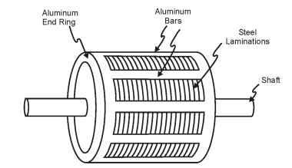
SQUIRREL CAGE ROTOR
Squirrel cage motor is one of the types of induction motors. In order to generate motion, it hardens electromagnetism.
As the output shaft is connected to the rotor inner component which is looking like a cage. Hence it is called squirrel cage.
In order to avoid hysteresis and eddy currents that are leading to power loss, the rotor is laminated.
Fig.6
https://www.electrical4u.com/squirrel-cage-induction-motor/

Slide 12
ADVANATGES & DISADVANTAGES OF SQUIRREL CAGE ROTOR
Advantages:
Simple and rugged construction.
The low initial as well as maintenance cost.
Maintains constant speed.
Disadvantages:
High starting current.
Very sensitive to fluctuations in supply voltage.
Low power factor at light loads.

Slide 13
APPLICATIONS OF SQUIRREL CAGE ROTOR
The applications of squirrel cage induction motor include the following.
Suitable for industrial drives of small power where speed control is not required such as for printing machinery, flour mills, and other shaft drives of small power.
Centrifugal pumps, fans, blowers, etc

Slide 14
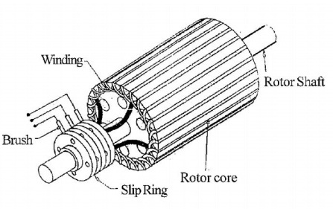
SLIP RING ROTOR
A slip ring induction motor is referred to as an asynchronous motor as the speed at which it operates is not equal to the synchronous speed of a rotor.
The rotor of this type of motor is wound type. It comprises of a cylindrical laminated steel core and a semi-closed groove at the outer boundary
Fig.7
https://www.elprocus.com/what-is-slip-ring-induction-motor-and-its-working/

Slide 15
ADVANATGES & DISADVANTAGES OF SLIP RING ROTOR
Advantages:
High and excellent starting torque to support high inertia loads.
It has a low starting current due to external resistance.
Can take full load current that is 6 to 7 times higher.
Disadvantages:
Includes higher maintenance costs due to brushes and slip rings compared to squirrel cage motor.
Intricate construction.

Slide 16
APPLICATIONS OF SLIP RING ROTOR
The applications of slip ring induction motor include the following.
These motors are used where higher torque and low starting current are required.
Used in applications like elevators, compressors, cranes, conveyors, hoists, and many more.

Slide 17
DIFFERENCE BETWEEN SQUIRREL CAGE & SLIP RING INDUCTION MOTOR
Parameters | Slip ring | Squirrel cage
Rotor | It has a rotor of wound type | Its rotor is of squirrel cage type.
Rotor slots | Rotor has cylindrical core has parallel slots, in which each slot has a bar | Slots are not parallel to each other
Construction | Construction is complicated because of slip rings and brushes | Simple construction
Table.1

Slide 18
Difference Between AC and DC Supply
DIFFERENCE BETWEEN SQUIRREL CAGE & SLIP RING ROTOR
Parameter | Slip ring | Squirrel cage
External resistance | External resistance circuit is connected with a motor | No external resistance circuit as bars of the rotor is completely slotted
Starting torque | High | Low
Efficiency | Low | High
Contd. Table.1

Slide 19
WORKING PRINCIPLE OF SINGLE PHASE INDUCTION MOTOR
In the single-phase induction motor, single-phase a.c supply is given to the stator winding. The stator winding carries an alternating current which produces the flux which is also alternating in nature. This flux is called the main flux.
This flux links with the rotor conductors and due to transformer action e.m.f gets induced in the rotor.
The induced emf drives current through the rotor as the rotor circuit is the closed circuit.

Slide 20
WORKING PRINCIPLE OF SINGLE PHASE INDUCTION MOTOR
This rotor current produces another flux called rotor flux required for the motoring action. Thus second flux is produced according to the induction principle due to induced e.m.f hence the motor is called induction motor.
As against this in d.c motor a separate supply is required to the armature to produce armature flux. This is an important difference between d.c motor and an induction motor.

Slide 21
APPLICATIONS OF SINGLE PHASE INDUCTION MOTOR
Fans
Refrigerators
Air-conditioners
Vacuum cleaners
Washing machines
Centrifugal pumps
Small farming appliances

Slide 22
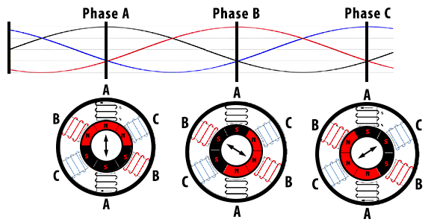
INTRODUCTION TO THREE PHASE INDUCTION MOTOR
The three phase induction motor is a preferable type of motor. It is mostly used in industrial drives because it is very reasonable and vigorous, economical and reliable.
It is also called asynchronous motor because it does not run at a synchronous speed.
The induction motor requires very little maintenance and also it has high overloading capacity.
Fig. 8
https://www.kebamerica.com/blog/how-a-3-phase-ac-induction-motor-works/

Slide 23
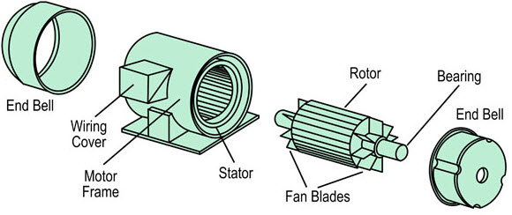
INTRODUCTION TO THREE PHASE INDUCTION MOTOR
In the case of three phase AC (alternating current) operation, the most widely used motor is a 3 phase induction motor, as this type of motor does not require an additional starting device.
These types of motors are known as self-starting induction motors.
Fig. 9
https://www.elprocus.com/three-phase-ac-induction-motor-control-using-svpwm/

Slide 24
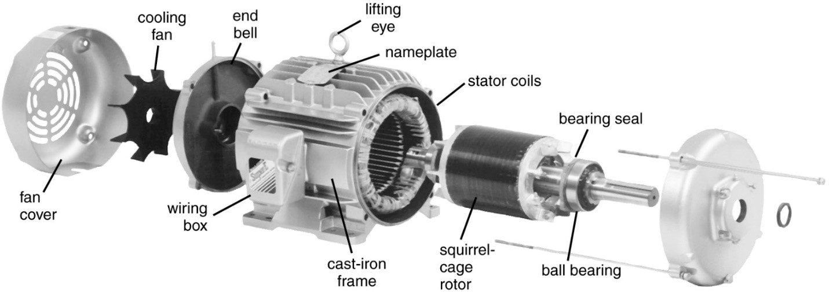
CONSTRUCTION OF THREE PHASE INDUCTION MOTOR
A three phase Induction motor mainly consists of two parts called as the Stator and the Rotor.
The stator is the stationary part of the induction motor, and the rotor is the rotating part.
There are two types of rotor such as:
Squirrel cage
Slip ring
Fig. 10
https://electricalacademia.com/induction-motor/three-phase-induction-motor-construction/

Slide 25
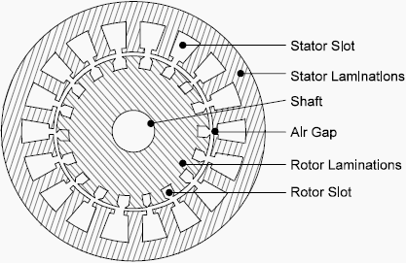
STATOR OF THREE PHASE INDUCTION MOTOR
The stator is built up of high-grade alloy steel laminations to reduce eddy current losses.
It has three main parts, namely outer frame, the stator core and a stator winding.
Fig. 11
https://electrical-engineering-portal.com/construction-of-3-phase-ac-induction-motors

Slide 26
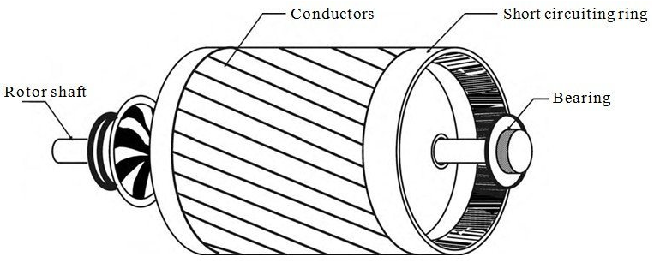
SQUIRREL CAGE ROTOR
A squirrel cage rotor consists of a laminated cylindrical core.
The circular slots at the outer periphery are semi-closed.
Each slot contains uninsulated bar conductor of aluminium or copper.
Fig. 12
https://www.theengineeringprojects.com/2016/10/squirrel-cage-induction-motor.html

Slide 27
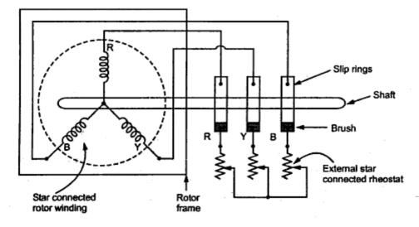
SLIP RING ROTOR OR PHASE WOUND ROTOR
The Phase wound rotor is also called as Slip Ring Rotor.
It consists of a cylindrical core which is laminated.
The outer periphery of the rotor has a semi-closed slot which carries a 3 phase insulated windings. The rotor windings are connected in star.
Fig. 13
https://electricallive.com/2015/03/slip-ring-rotor-or-wound-rotor-in-three.html

Slide 28
WORKING OF THREE PHASE INDUCTION MOTOR
When 3 phase supply is given to the motor, the resulting current generates a magnetic flux “Ø”.
Due to the switching sequence of 3 phase current in R, Y, and B, the generated flux rotates around the rotor conductor.
According to Faraday’s law, which states that –“an emf induced in any closed circuit is due to the rate of change of magnetic flux through the circuit”, Emf is induced in the copper bar and due to this, current flows in the rotor.

Slide 29
WORKING OF THREE PHASE INDUCTION MOTOR
The direction of the rotor can be given by Lenz law which states that – “the direction of induced current will be in the opposite of the motion causing it.”
Here the relative velocity between the rotating flux and static rotor conductor is the cause of current generation; hence the rotor will rotate in the same direction to reduce the cause i.e. the relative velocity, thus rotating the rotor of the induction motor.

Slide 30
SPEED OF THREE PHASE INDUCTION MOTOR
The speed of three phase induction motor is given by:
Ns = 120f/P
Where
Ns = synchronous speed
f = supply frequency
P = number of poles

Slide 31

SLIP OF SINGLE PHASE INDUCTION MOTOR
The slip in an induction motor is the difference between the main flux speed and their rotor speed.
The symbol S represents the slip. It is expressed by the percentage of synchronous speed. Mathematically, it is written as
Where Ns is synchronous speed and Nr is rotor speed.

Slide 32

ROTOR SPEED OF SINGLE PHASE INDUCTION MOTOR
The rotor speed is given by the equation shown below.
Alternatively, if
Ns is the synchronous speed in revolution per second
Nr is the actual rotor speed in revolution per second.
S is slip.

Slide 33
FREQUENCY OF ROTOR
The rotor frequency is given by the equation shown below.
fr = s. fs
Where fr is rotor frequency
s is slip
fs is supply frequency
At standstill condition
Slip s = 1, then rotor frequency
fr = 1. fs

Slide 34
ADVANTAGES OF THREE PHASE INDUCTION MOTOR
Advantages:
They are robust and simple in construction with very few moving parts
They can efficiently operate in a rugged and harsh environment such as in seagoing vessels
The maintenance cost of 3 phase induction motor is less and unlike that of DC or synchro motor, they do not have parts like brushes, commuters or slip rings etc.

Slide 35
DISADVANTAGES OF THREE PHASE INDUCTION MOTOR
Disadvantages:
During starting, it draws high initial starting current when attached to a heavy load.
Induction motor operates at lagging power factor which results in increased I2R losses and efficiency reduction, especially at low load.
Speed control of 3 phase induction motor is difficult as compared to DC motors.

Slide 36
APPLICATIONS OF THREE PHASE INDUCTION MOTOR
Lifts
Cranes
Large capacity exhaust fans
Engine Auxiliary pumps
Engine blower fan motor

Slide 37
DIFFERENCE BETWEEN SINGLE PHASE & THREE PHASE INDUCTION MOTOR
Parameters | Single phase induction motor | Three phase induction motor
Supply | Single Phase induction motor uses single phase supply, for its operation. | Three Phase induction motor uses three phase supply, for its operation
Maintenance | They are easy to repair and maintain. | Difficult to repair and maintain.
Efficiency | Efficiency is less | Efficiency is high
Table.1

Slide 38
DIFFERENCE BETWEEN SINGLE PHASE & THREE PHASE INDUCTION MOTOR
Parameters | Single phase induction motor | Three phase induction motor
Power Factor | Power factor is low | Power factor is high
Applications | They are mostly used in domestic appliances such as mixer grinder, fans, compressors etc | Three phase induction motors are mostly used in industries.
Cost | Cheaper | Quiet expensive
Table.1

Slide 39
SUMMARY
Introduction to single phase induction motor.
Construction of single phase induction motor.
Working principle of single phase induction motor.
Difference between squirrel cage and slip ring rotor.
Introduction to three phase induction motor.
Construction and working of three phase induction motor.
Difference between single phase and three phase induction motor.

Slide 40
FREQUENTLY ASKED QUESTIONS
What do you understand by single phase induction motor?
What is the difference between squirrel cage and slip ring rotor?
What is meant by slip in induction motor?
Give the brief description of three phase induction motor.
Differentiate between single phase and three phase induction motor.

Slide 41

LEARNING OUTCOMES
To make students understand
Concepts of single phase induction motor
Difference between squirrel cage and slip ring rotor
Fundamentals of three phase induction motor with its construction and working operation

Slide 42
Course Outcome to Program Outcome Relationship
 |  | (21ELH-101) BEEE
PO→
CO↓ | PO1 | PO2 | PO3 | PO4 | PO5 | PO6 | PO7 | PO8 | PO9 | PO10 | PO11 | PO12 | PSO1 | PSO2 | PSO3
CO1 | 3 | 2 |  |  |  |  |  |  |  |  |  |  | 3
CO2 | 3 | 2 |  |  |  |  |  |  |  |  |  |  | 3
CO3 | 3 | 2 |  |  |  |  |  |  |  |  |  |  | 3
CO4 | 3 | 2 |  |  |  |  |  |  |  |  |  |  | 3
CO5 | 3 | 2 |  |  |  |  |  |  |  |  |  |  | 3

Slide 43
ASSESSMENT PATTERN
A Assignment (each assignment) | B Time Bound Surprise Test (each test) | C Quiz (each quiz) | D Mid Semester Test(one per test) | E Homework | F Discussion Forums | G Attendance and engagement Score on BB
10 | 12 | 4 | 20 | NA | NA | 2

Slide 44
REFERENCES FOR FURTHER HIGHER LEARNING
https://www.sciencedirect.com/topics/computer-science/electrical-network
https://www.electricaltechnology.org/2014/01/important-terms-related-to-electric-circuits-and-networks.html

Slide 45
REFERENCES
Books: [1]Basic of Electrical Engineering, T. K. Nagsarkar and M. S.Sukhija,2013 ,2nd edition
[2]Theory and problems of Basic Electrical Engineering, J. Nagrath and Kothari, 2012, 2nd edition
[3] A Textbook of Electrical Technology, B.L Theraja,2010,Vol 1
[4] Fundamentals of Electrical and Electronics Engineering, Smarjith Ghosh,2013,1st edition
E-Books: [1] file:///C:/Users/user/Desktop/BLACK%20BOARD%20MATERIAL%20PEE/UNIT-2%20PEE/Lecture%203%20&%204/doku.pub_basic-electrical-engineering-vkmehta-e-schand.pdf
[2] file:///C:/Users/user/Desktop/BLACK%20BOARD%20MATERIAL%20PEE/UNIT-2%20PEE/Lecture%203%20&%204/Elements%20Of%20Electrical%20Engineering%20By%20V.%20U.%20Bakshi%20and%20U.%20A.%20Bakshi.pdf
Websites: [1] https://www.electricalengineeringinfo.com/2017/01/single-phase-induction-motors-working-principle-construction.html
[2] https://circuitglobe.com/working-principle-of-single-phase-induction-motor.html
[3] https://www.elprocus.com/what-is-a-squirrel-cage-induction-motor-and-its-working/
[4] https://www.elprocus.com/what-is-slip-ring-induction-motor-and-its-working/
Videos: [1] https://youtu.be/awrUxv7B-a8
[2] https://youtu.be/AhxMrUo806Y
[3] https://youtu.be/cuwSCutTHEI

Slide 46
THANK YOU
For queries
Email: Shikha.e12701@cumail.in

